Slide 1
OBI & Evidence Ontology (ECO) goals
ECO
  Clarify meaning of “evidence”
    Ad hoc development history mixed axes
  Leverage OBI to create granular classes to represent evidence, as outputs of processes
  Developed in OBO (less expressive than OWL)
OBI
  Model drawing conclusions in experimental research
  Represent ECO’s evidence classes, which cover many assays in broad areas of science

Slide 2
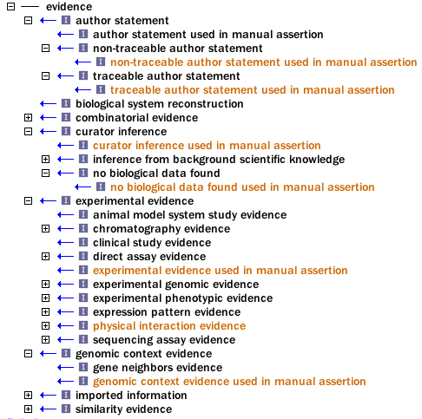




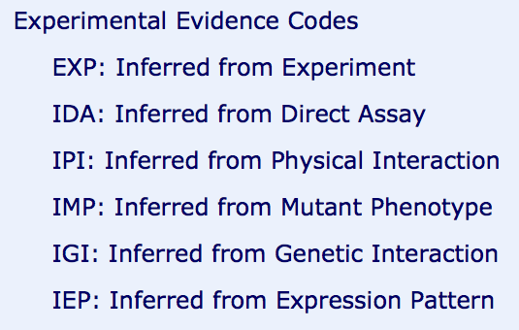



GO codes are ECO subset
  Approximately 20 GO codes exist
  …some of the over 250 ECO terms

Slide 3
Bjoern’s model from OBI Philly (2011)
curator
Evidence code
creates
Reads + interprets
Literature curation is one example for evidence code creation. Automated assertions are produced by e.g. PAINT.
Researchers can also create assertions
Journal article
writes
Below is what needs to be in OBI
author
investigation
conducts
Has part
data
Drawing conclusion
conclusion

Slide 4


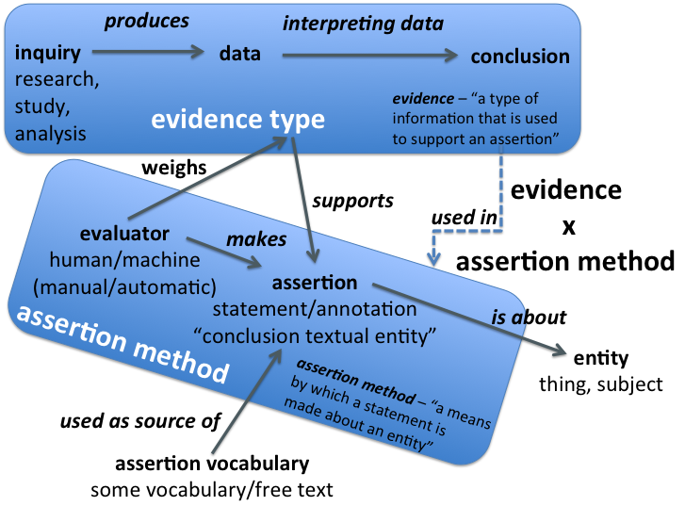

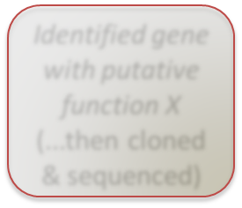



A general (ECO) model of evidence & annotation
Sequence similarity analysis
Southern blot experiment
Pairwise alignment
My protein looks just like protein X in some database (conclusion 1)
Southern blot
What was done (OBI & ECO)
My probe hybridized to specific DNA fragment(s) on membrane
My protein has function of protein X, which is function ABC (conclusion 2)
Identified gene with putative function X (...then cloned & sequenced)
My protein has function ABC (conclusion 2)
Organism has gene for protein involved in X biological process
Assertion vocabulary
My protein
How it was applied (ECO)
Protein or organism
GO:0031217 : glucan 1,4-beta-glucosidase activity
GO:0005471 ATP:ADP antiporter activity
M. Chibucos unpublished figure

Slide 5
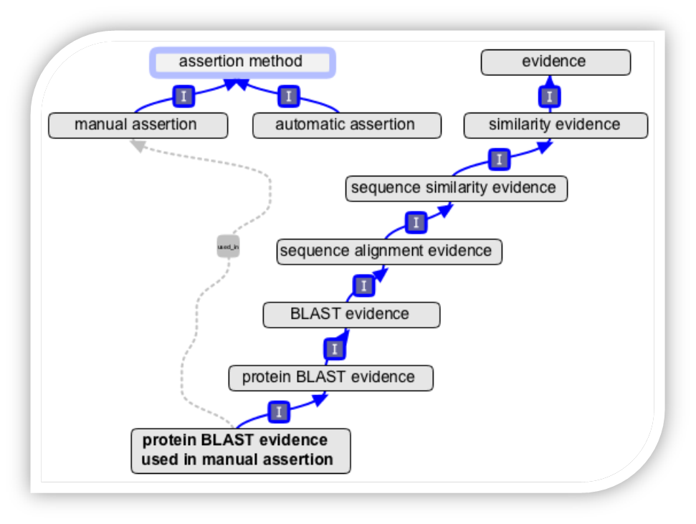
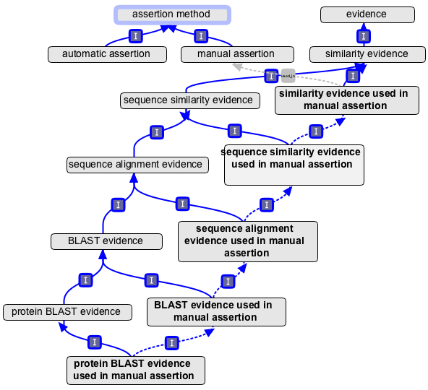
ECO evidence & assertion method
used_in

Slide 6
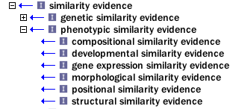

One more axis to clarify…
Key point (Philippe):
  Confusion remains about whether ECO terms are about the technology or the objective of the study in question, e.g. morphology assessment
  Must know axes for QTT
    type of assay used
    objective of study
objective
technology

Slide 7
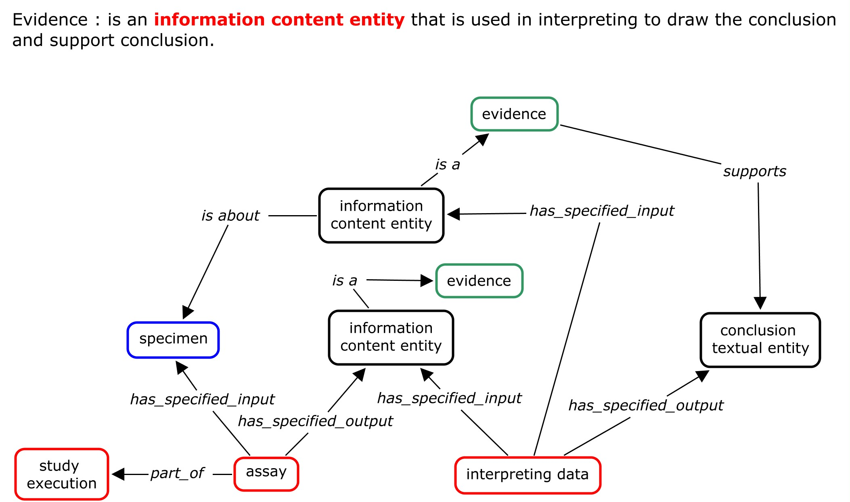
What is Evidence? (1)

Slide 8
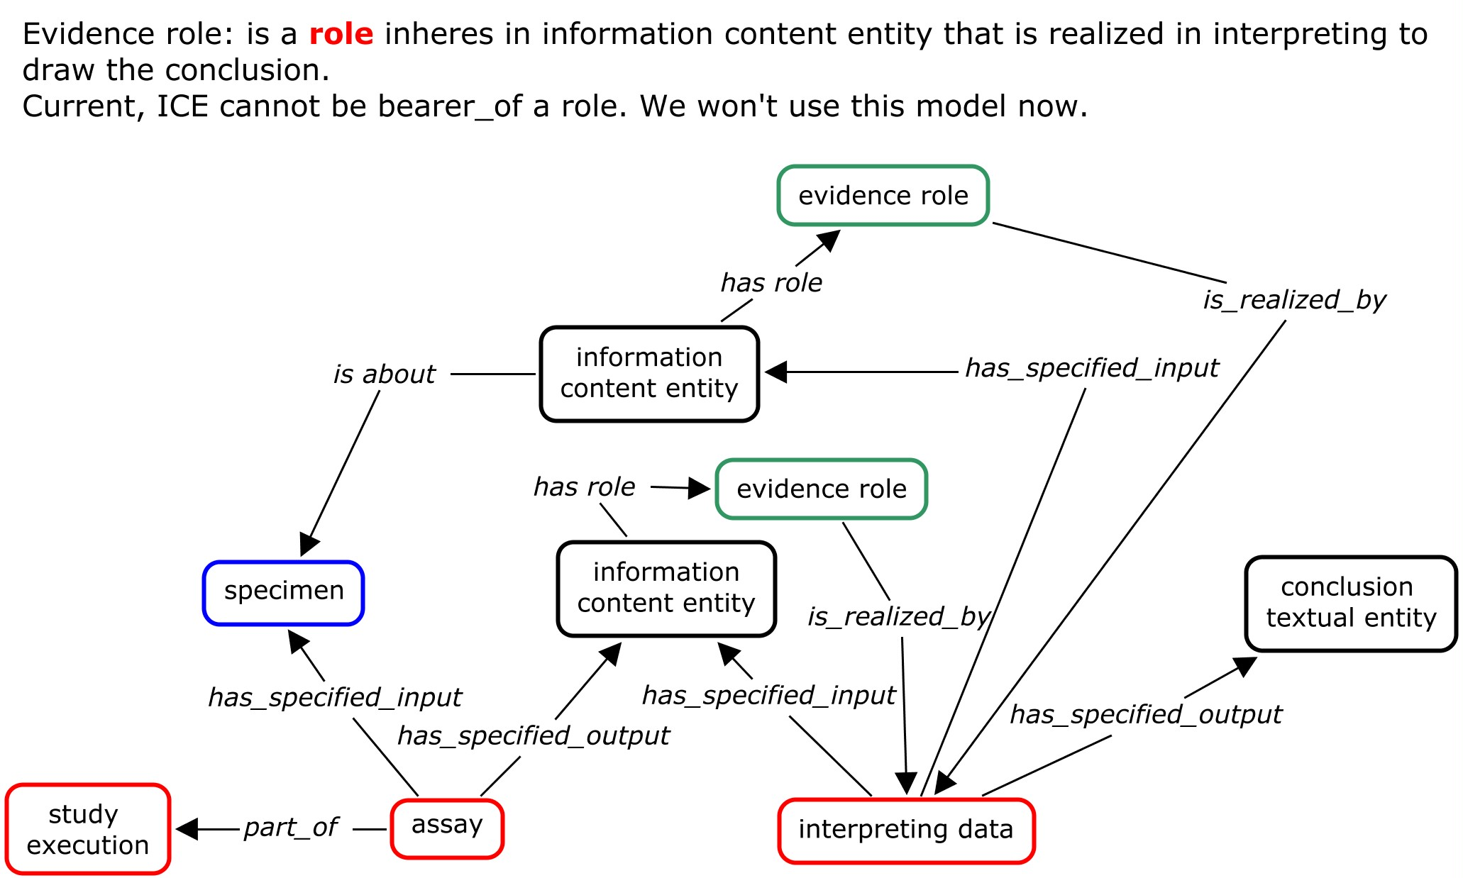
What is Evidence? (2)

Slide 9
Where are we going with OBI?
Some areas of agreement (among a subset of developers discussing evidence recently)
Context is critical (issues of specificity)
Output of Southern blot might be a blot, but just a meaningless picture unless you know information about lane, samples, et cetera (Bjoern from recent call)
  implicitly there is information about protocol, sample collection, etc.
  not attempting to capture necessary and sufficient conditions… not excluding all the other stuff, but it's sufficient to just point to the drawing a conclusion based on Southern blot
  MAIN point: James/Bjoern – strive for comparability at different scales of modeling.
Evidence is information content entity, used as input of drawing a conclusion and support the conclusion
One ECO evidence term should correspond to one OBI class
  …that OBI class can point to many others with relationships
A conclusion can be an input into another conclusion

Slide 10
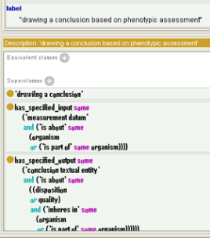
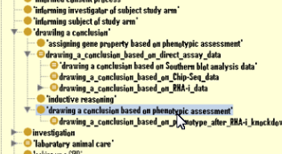
Proposal: subclass “drawing a conclusion” (previously “interpreting data”)
Protein X has function Y tied to evidence code by saying this statement is output of one of these processes
planned process
interpreting data
phenotypic assessment
drawing a conclusion based on phenotype after RNA-i knockdown

Slide 11
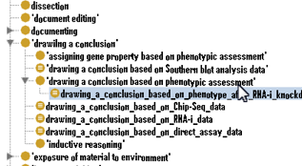
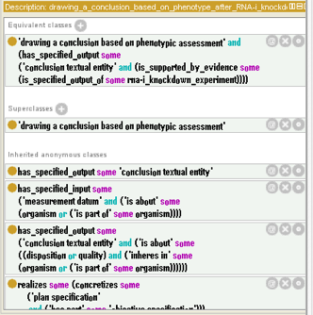
drawing a conclusion
  assigning gene property based on phenotypic assessment
  drawing a conclusion based on Southern blot analysis data
  drawing a conclusion based on a phenotypic assessment
    drawing a conclusion based on phenotype RNAi knockdown
  drawing a conclusion based on ChIP-seq data
  etc.

Slide 12
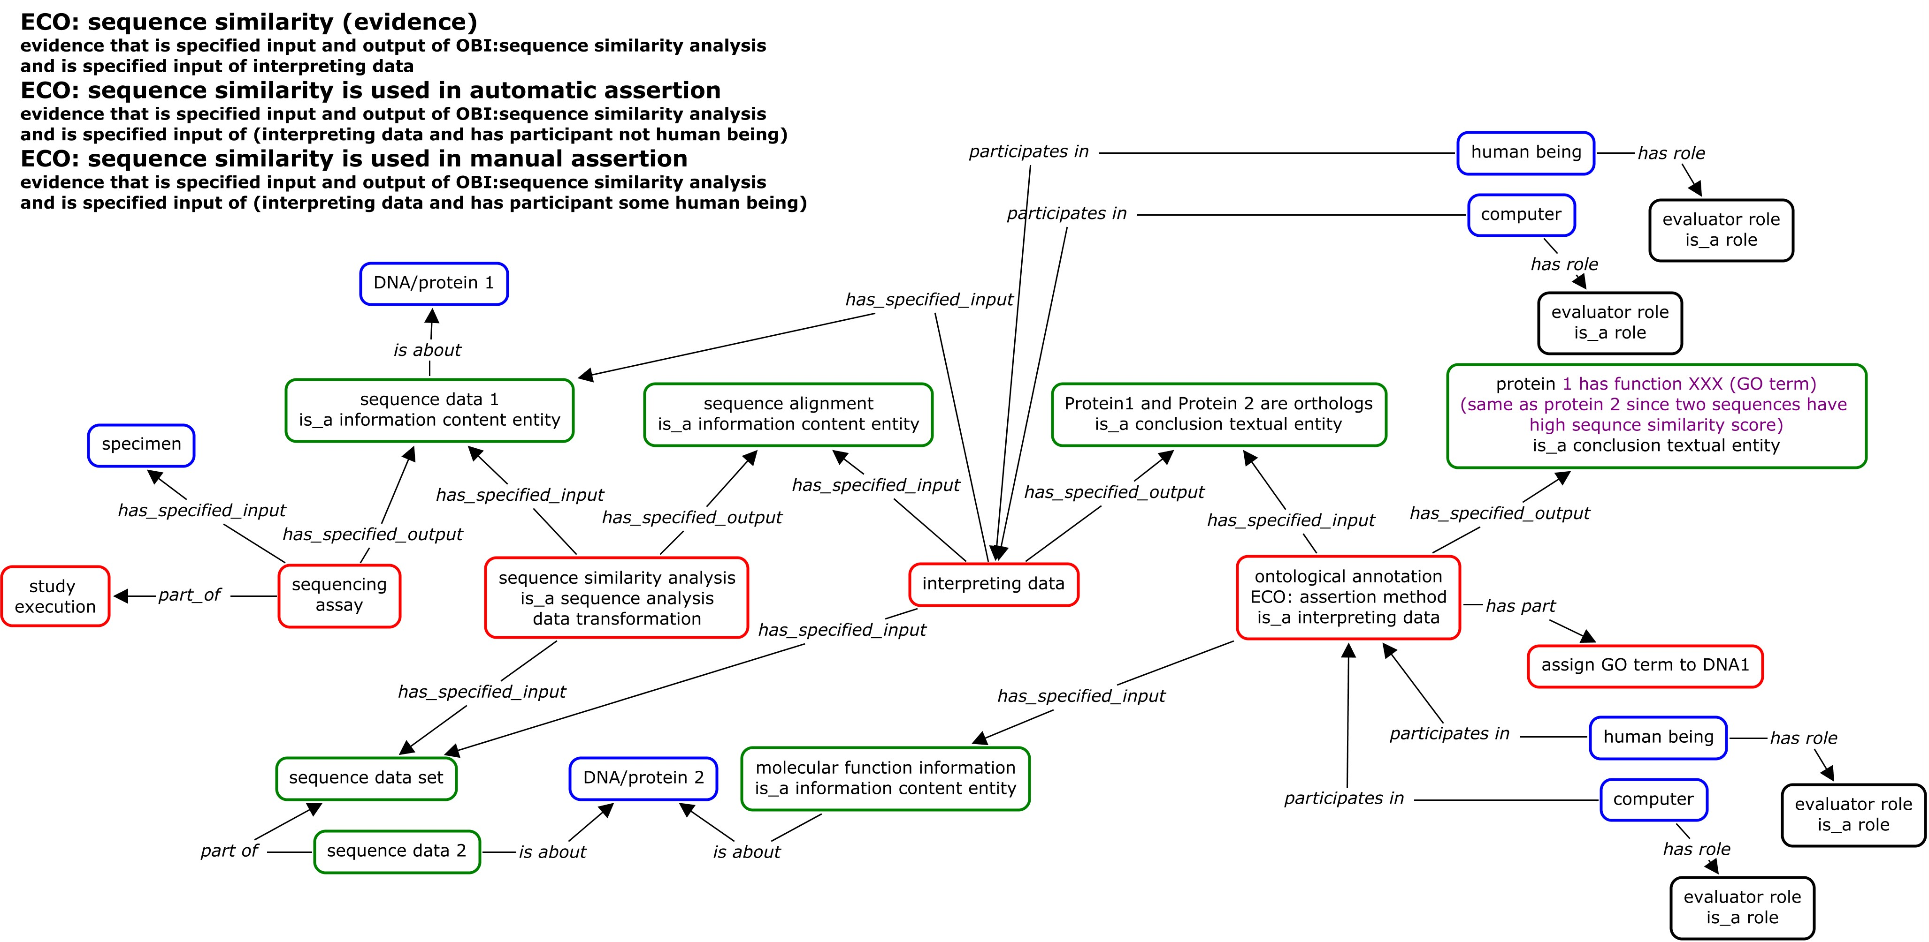
Example 1

Slide 13
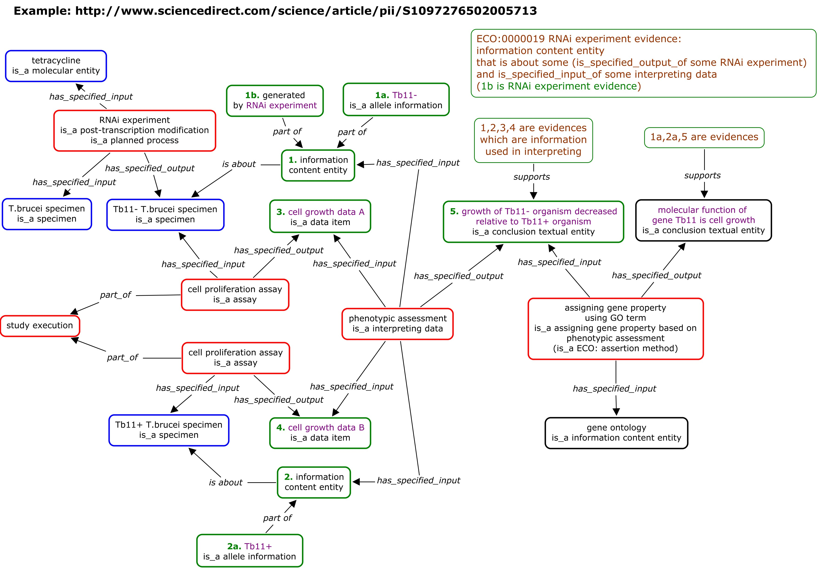
Example 2

Slide 14
Other considerations
Comparative studies
Not over-specifying
Jie discussing comparative analysis like RNAi, where you're comparing two things, one knocked down and one not.
RNAi in ECO is experimental phenotypic evidence… wrong, but created that way as ad hoc. So better to say "phenotypic conclusion derived from RNAi expt evidence"
You could draw other conclusion based on RNAi; it doesn't have to be phenotype.

Slide 15
QTT for ECO-OBI
Google doc
https://docs.google.com/spreadsheet/ccc?key=0AvCayBYdTclldFNKekt5RWhtMWg2Qk15UklCaDZUQ0E&pli=1#gid=0

